Slide 1
LOAN DATASET ANALYSIS
NAME: S. INDHUMATHI
COURSE: DATA ANALYTICS
BATCH : OCT-2025

Slide 2
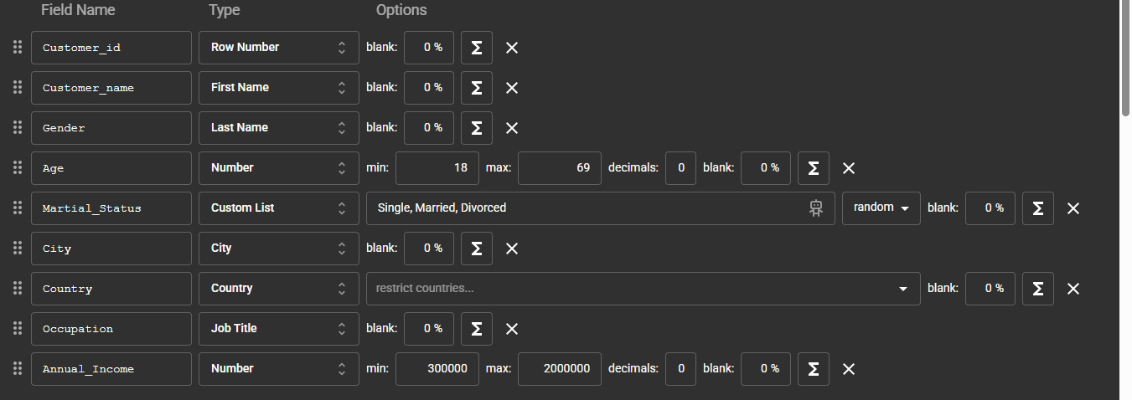
DATA PREPARATION
The loan dataset was generated using Mockaroo for analytical practice.
Total Records: 2000 rows
Total Attributes: 10 columns
The dataset represents customer demographic, financial, and loan-related information.
The data is structured and suitable for analysis using Excel, SQL, and Power BI.
The project aims to apply data cleaning, statistical analysis, SQL processing, and Power BI visualization techniques to extract meaningful insights.

Slide 3
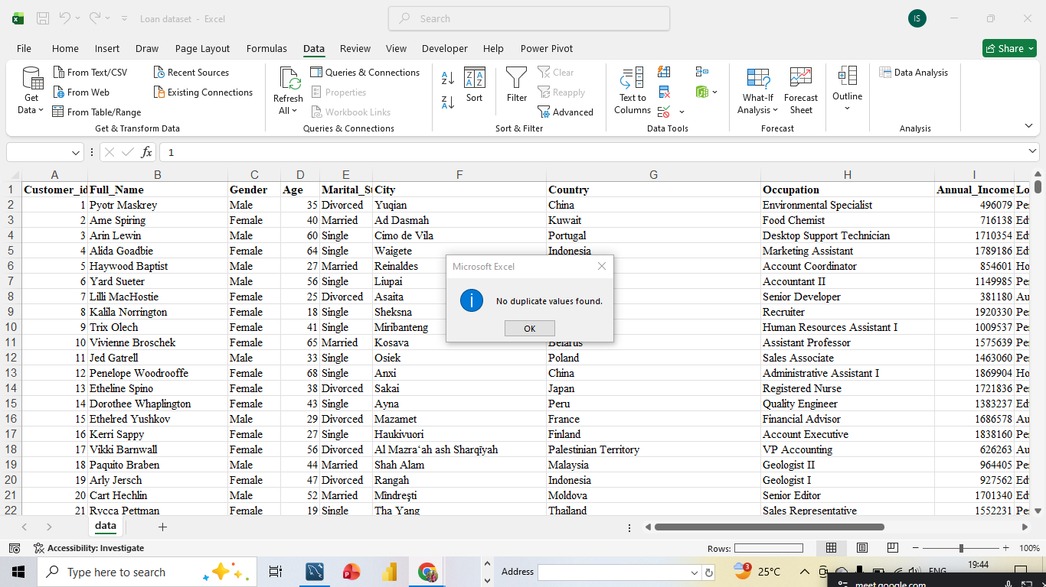
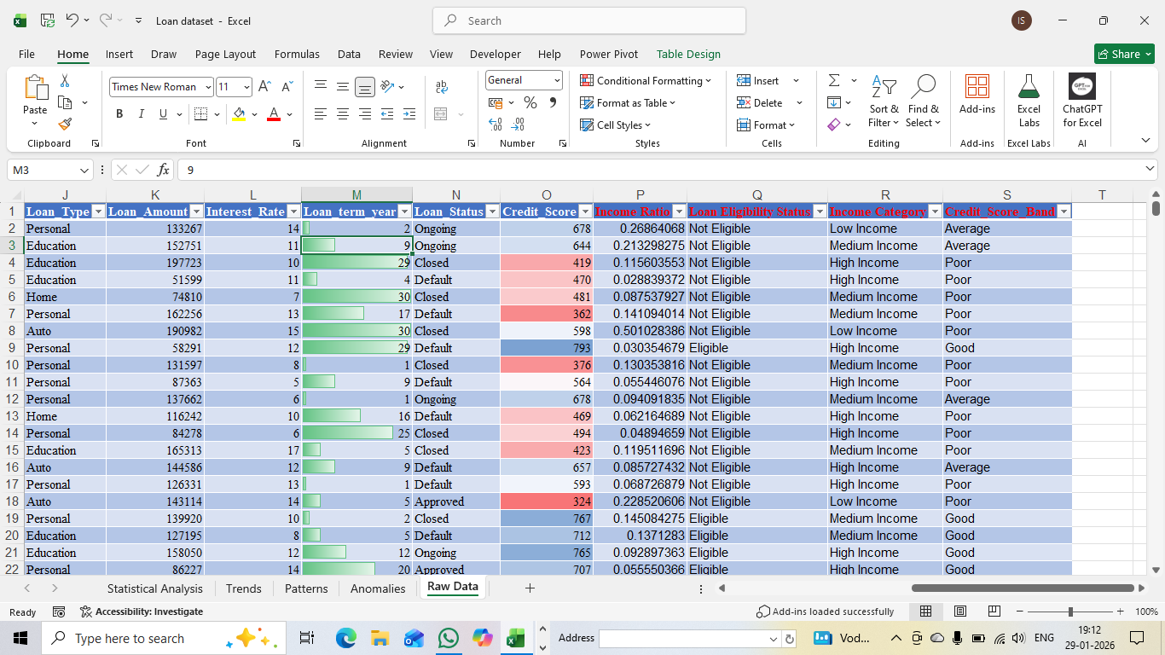
DATA CLEANING
Verified the dataset for missing and inconsistent values.
Removed duplicate and irrelevant records where necessary.
Standardized data types such as numeric, text, and date fields.
Ensured data consistency before performing analysis.

Slide 4
DERIVED COLUMN IN EXCEL
LOAN ELIGIBILITY STATUS
=IF(AND(O2>=700,I2>=400000),"Eligible", "Not Eligible")
INCOME CATEGORY
=IF(I2>=1500000,"High Income", IF(I2>=700000,"Medium Income", "Low Income"))
CREDIT SCORE BAND
=IF(O2>=800,"Excellent",IF(O2>=700,"Good",IF(O2>=600,"Average","Poor")))
INCOME RATIO
=LOAN AMOUNT/ANNUAL INCOME

Slide 5
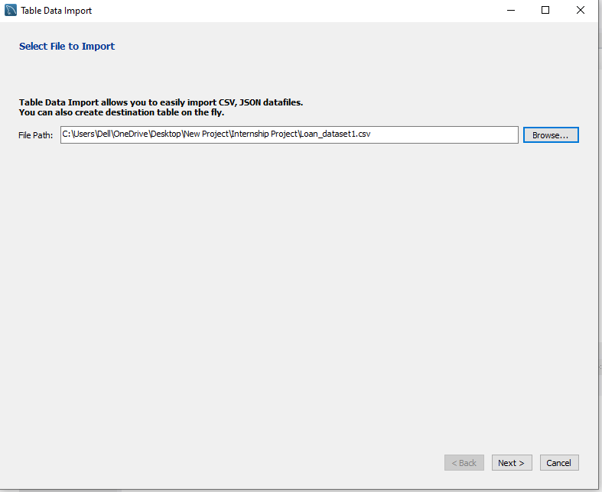
SQL PROCESSING
Imported the Excel-based loan dataset into a SQL database.
Used SQL queries to perform:
  Filtering of records
  Aggregation of numerical data
Prepared final analysis-ready tables for reporting and visualization.

Slide 6
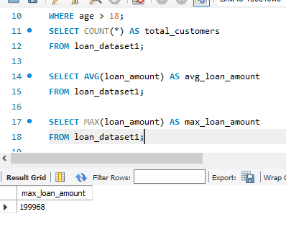
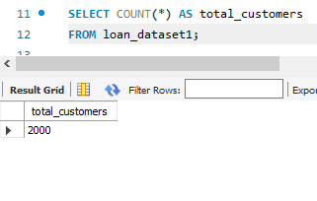
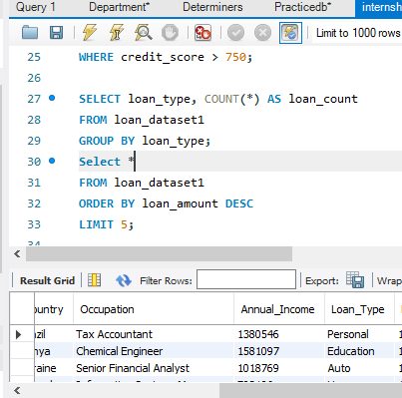
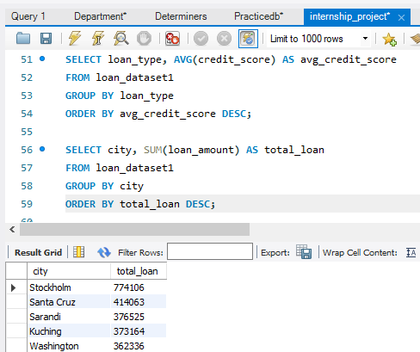
DATABASE CREATION IN SQL
Aggregation and Grouping
SQL aggregate functions such as SUM, AVG, and COUNT were applied.
Loan amounts and applicant income were summarized using GROUP BY.
Data Filtering and Selection
SQL WHERE clauses were used to filter relevant loan records.
Applicant records were segmented based on loan status and eligibility.

Slide 7
STATISTICAL ANALYSIS
The mean credit score (573.09) indicates the overall average creditworthiness of customers.
The median score (573) closely matches the mean, suggesting a well-balanced distribution.
Credit scores range from a minimum of 300 to a maximum of 850, showing wide variation in borrower risk profiles.
Statistical Analysis
Mean | 573.088044
Standard Error | 3.560118672
Median | 573
Mode | 847
Standard Deviation | 159.1735388
Sample Variance | 25336.21547
Kurtosis | -1.20193171
Skewness | 0.02292431
Range | 550
Minimum | 300
Maximum | 850
Sum | 1145603
Count | 1999
Confidence Level(95.0%) | 6.981933906

Slide 8
Trends, Patterns and Anomalies
Trends
The analysis shows that ongoing loans contribute the highest loan amount, indicating maximum capital exposure in active loans.
Patterns
Good and excellent credit score customers consistently show higher approvals and healthier loan status, revealing a strong creditworthiness pattern
Anomalies
Poor credit score customers holding a disproportionately high loan amount highlight a potential risk anomaly requiring further investigation.

Slide 9
POWER QUERY – CONDITIONAL & DERIVED COLUMNS IN POWER BI
Conditional Column Formula
Risk Level = ( if [Credit Score] < 600 then "High Risk" else if [Credit Score] < 750 then "Medium Risk" else "Low Risk“)
Interest Rate Category = ( if [Interest Rate] < 8 then "Low Interest" else if [Interest Rate] <= 14 then "Medium Interest" else "High Interest")
Column Formula
Total Amount = [Loan Amount]*[Interest Rate])
Interest Amount = ([Loan Amount]*[Interest Rate])/100)
EMI Amount = (([Loan Amount]*[Interest Rate])/100)/[Loan term year])

Slide 10
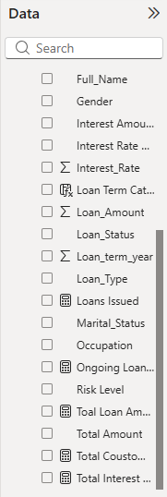
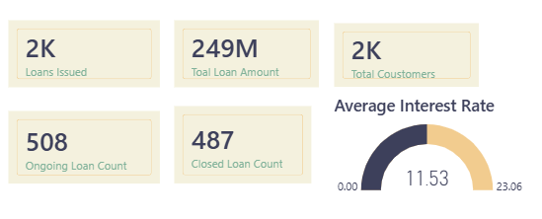
DAX MEASURES
The KPI cards provide a quick summary of overall loan performance and customer activity.
They highlight Total loans issued, Loan amount, Active and Closed loans, and Average interest rate.
These metrics help in monitoring business growth and lending efficiency at a glance.

Slide 11
DAX MEASURES FORMULA
Columns Formula
Loan Term Category = IF( [Loan term year] > 5, "Long Term", "Short Term")
Customer Profile = IF( Annual Income] > 600000 && [Credit Score] >= 700, "Premium Customer","Regular Customer")
EMI Category = IF( [Loan Amount] / ( [Loan term year] * 12) > 20000, "High EMI", "Low EMI“)
Measures Formula
Ongoing Loan Count = CALCULATE(COUNT( [Customer id]), [Loan Status] = "Ongoing“)
Loans Issued = COUNT( [Loan Amount])
Total Customer's = DISTINCTCOUNT( [Customer id])
Average Interest Rate = AVERAGE( [Interest Rate])
Closed Loan Count = CALCULATE(COUNT( [Customer id]), [Loan Status] = "Closed“)

Slide 12
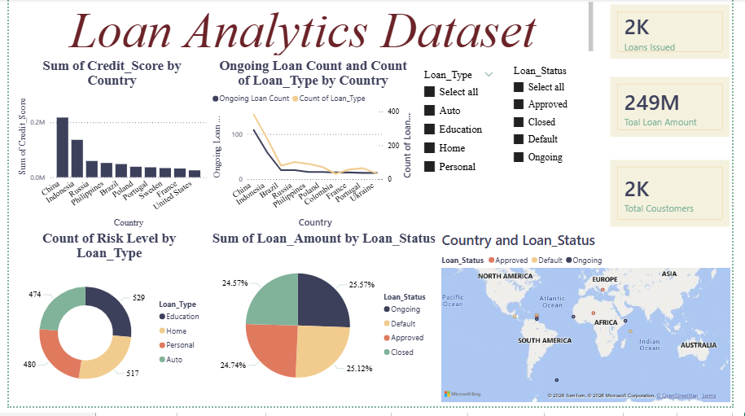
FIRST DASHBOARD VIEW

Slide 13
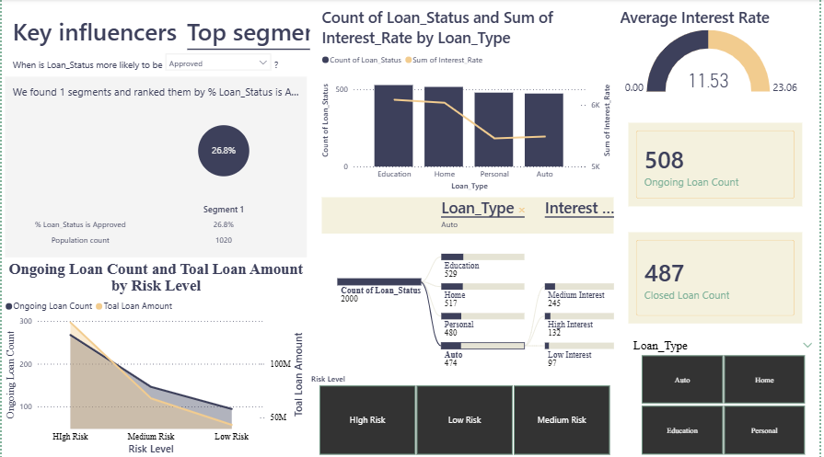
SECOND DASHBOARD VIEW

Slide 14
Problem Understanding & Objective Clarity
The project aims to evaluate loan performance by analyzing customer profiles, loan characteristics, and repayment behavior.
The key objective is to identify factors influencing loan approval, default risk, and overall portfolio health.
This analysis supports data-driven decision-making for risk management and loan optimization.
Statistical Analysis & Interpretation
Descriptive statistics were used to understand the distribution of loan amount, interest rate, and tenure.
Credit score and interest rate show a significant influence on loan approval and default patterns.
Higher loan amounts combined with longer tenure increase repayment risk.

Slide 15
Insight Relevance & Business Alignment
The analysis clearly identifies customer and loan factors that directly impact approval and default behavior.
High credit score customers demonstrate better repayment performance, aligning with profitability goals.
High-risk and high-interest loans show increased default probability, supporting risk mitigation strategies.
Customer segmentation enables targeted lending and improved portfolio management.
Overall insights align with business objectives of reducing risk and maximizing returns.

Slide 16
Recommendations
Strengthen credit evaluation criteria for low credit score customers.
Introduce tighter monitoring for high-interest and long-tenure loans.
Use risk-based pricing and customer segmentation to improve portfolio performance.
Conclusion
The loan dataset analysis provides actionable insights into customer behavior and risk patterns.
Power BI dashboards enable clear visualization and effective interpretation of complex data.
Implementing these insights can enhance decision-making, reduce defaults, and improve business outcomes.

Slide 17
Thank You

